Slide 1






Slide 2




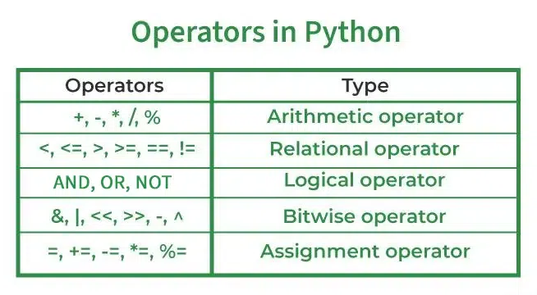
Python n stuff

Slide 3



BIT
They operate at the binary level and perform operations on bit patterns that involve the manipulation of individual bits. Thus, unlike common logical operators like + or - which work with bytes or groups of bytes, bitwise operators can check each individual
IN PYTHON:
The integers are converted into binary format and then operations are performed bit by bit, hence the name bitwise operators. Python bitwise operators work on integers only and the final output is returned in the decimal format. Python bitwise operators are also called binary operators.

Slide 4


(bitwise operators)
x << y
Returns x with the bits shifted to the left by y places (and new bits on the right-hand-side are zeros). This is the same as multiplying x by 2**y.
x >> y
Returns x with the bits shifted to the right by y places. This is the same as floor division of x by 2**y.
x & y
Does a "bitwise and". Each bit of the output is 1 if the corresponding bit of x AND of y is 1, otherwise it's 0.

Slide 5


x | y
Does a "bitwise or". Each bit of the output is 0 if the corresponding bit of x AND of y is 0, otherwise it's 1.
~ x
Returns the complement of x - the number you get by switching each 1 for a 0 and each 0 for a 1. This is the same as -x - 1.
x ^ y
Does a "bitwise exclusive or". Each bit of the output is the same as the corresponding bit in x if that bit in y is 0, and it's the complement of the bit in x if that bit in y is 1.

Slide 6
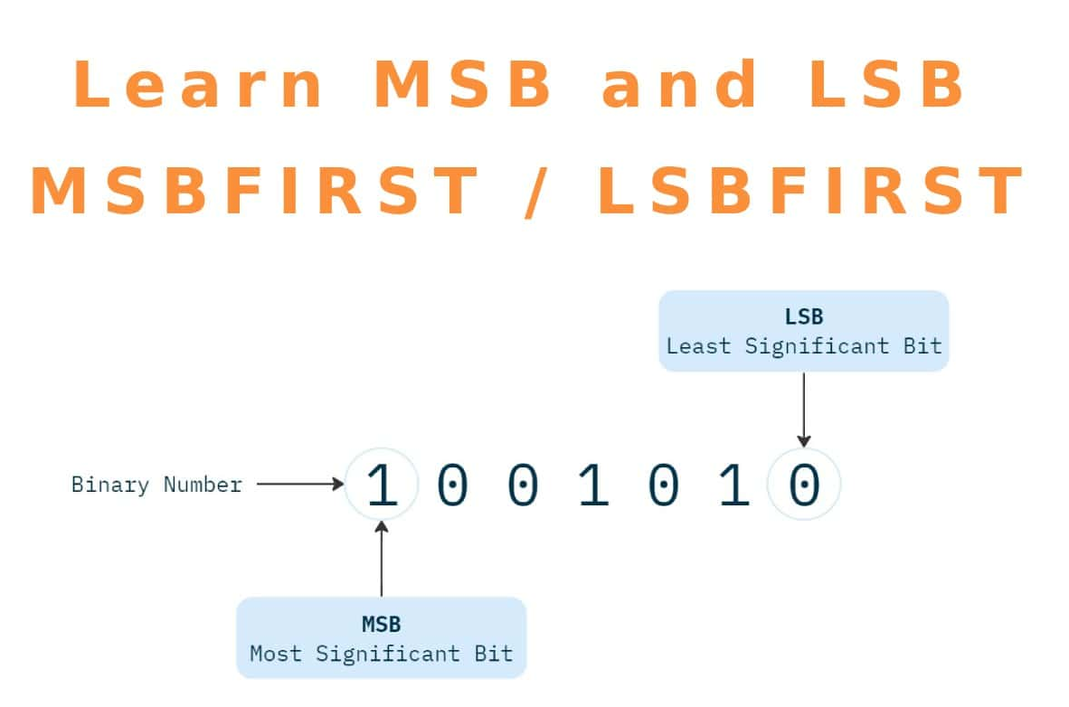



Slide 7

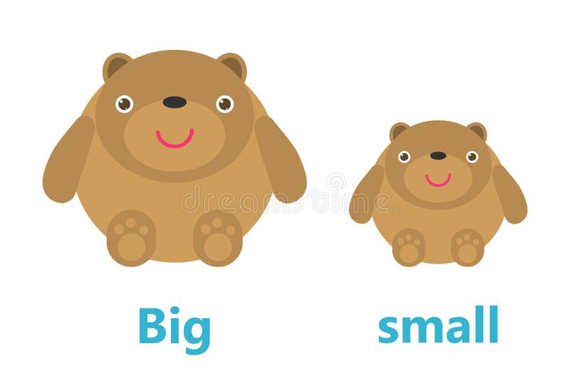
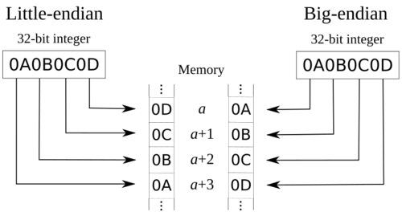
Endianness refers to the order of storing and reading multi-byte words in memory. Endianness determines if the least significant byte of a word that we want to store in memory will go to lowest or the highest address of the assigned memory space.

Slide 8

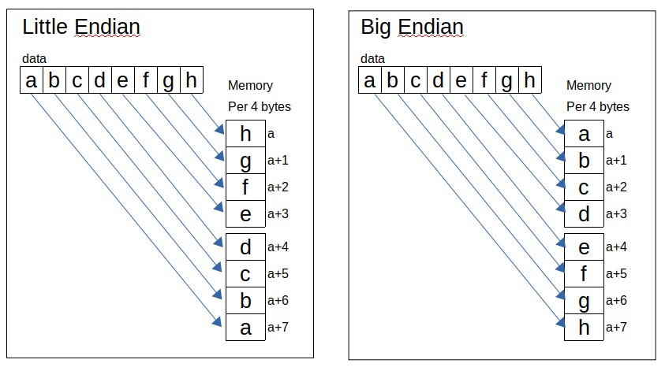
(I thought this diagram looked more understandable)

Slide 9
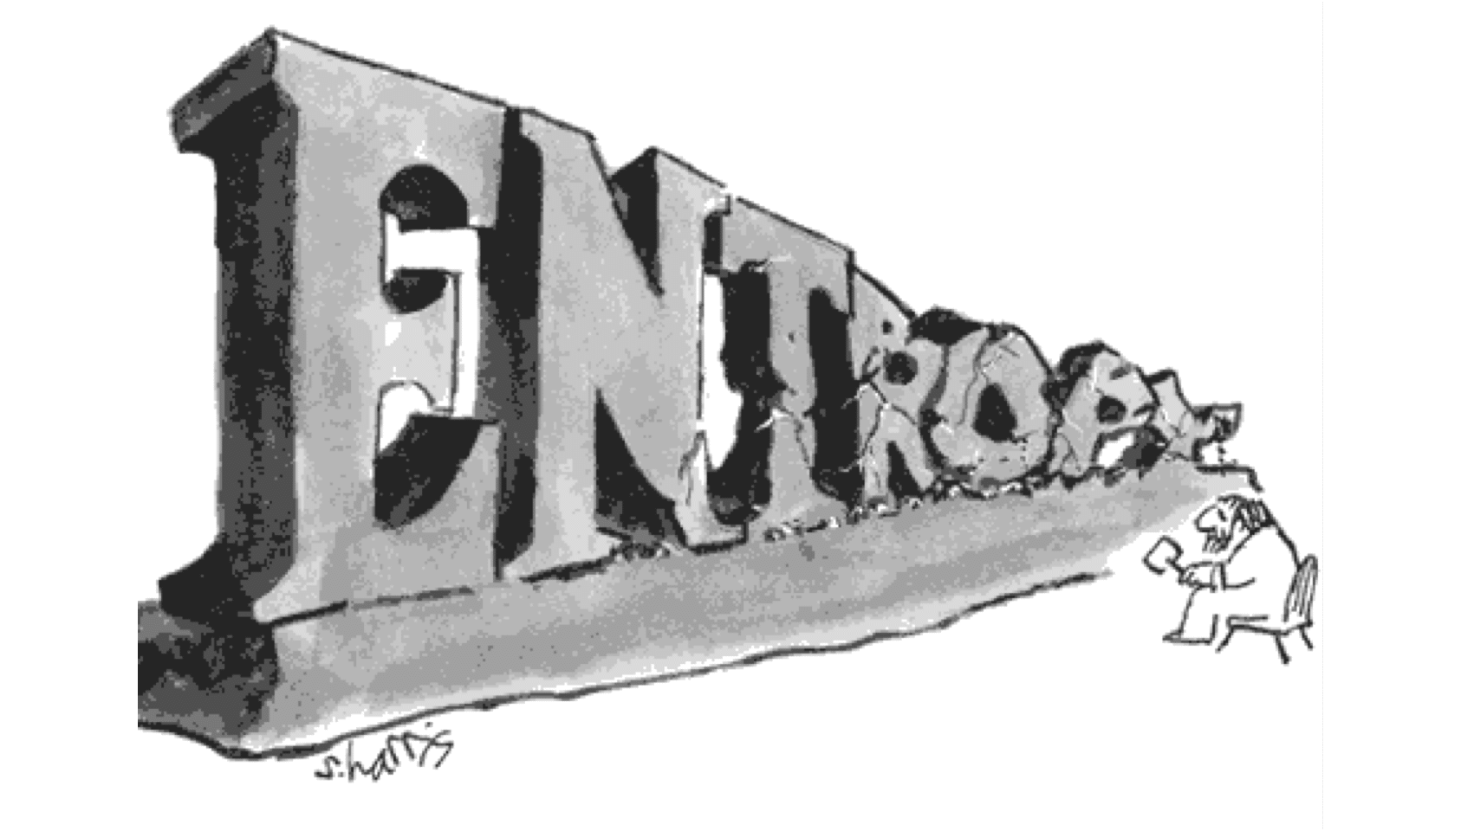
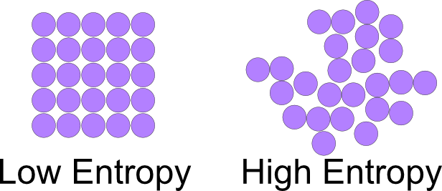

Entropy is a measure of the randomness or unpredictability of data. In the context of cryptography, entropy is used to generate random numbers or keys that are essential for secure communication and encryption.

Slide 10


High entropy indicates less predictable and less actionable data.
Low entropy means more structured and usable data.
Entropy is critical in decision trees, helping determine the most efficient data splits for accurate predictions.

Slide 11


AES is a symmetric-key algorithm, meaning the same key (aka passphrase or password) is used to encrypt and decrypt the data.

Slide 12
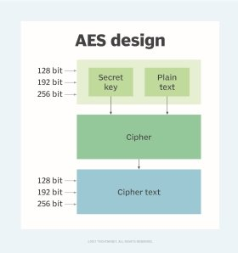
The AES algorithm can be divided into 3 main parts:
Generate a key - AES requires a secret passphrase known as a “key” to encrypt/decrypt data.
Generate a cipher - the algorithm used to perform encryption/decryption.
Encrypt/decrypt the data with the cipher

Slide 13






AES is considered unbreakable as long as the properties of the function are respected―strong key, correctly implemented cipher, unique nonce, unique initialization vector, etc.

Slide 14





